Slide 1

Flame Extinguisher AI: Advanced Threat Management System
An engineering deep-dive into building an intelligent agent that dynamically evaluates threats, prioritizes targets, and survives through real-time scenario analysis.
1

Slide 2
Understanding the Challenge
Core Game Mechanics
Key Edge Cases
The agent operates in a dynamic arena where survival depends on balancing multiple competing objectives: extinguishing flames, avoiding threats, and collecting power-ups.
Blue campfires that move vs. stationary
Corner death zones with limited escape
Multi-target super bullet opportunities
Risk assessment for power-up collection
Success requires understanding edge cases like stationary vs. moving campfires, corner traps, and optimal shooting ranges.
Threat clustering and escape routes
2

Slide 3

Our Engineering Journey
01
Initial Experiments
Tested parameter tuning approaches with detection radius and bullet speed modifications
02
Rule-Based Logic
Attempted conditional decision trees with distance comparisons
03
Aggressive Targeting
Explored pure offensive strategy focusing on nearest flame
04
Final Solution
Developed dynamic, scenario-based system with real-time evaluation
3

Slide 4
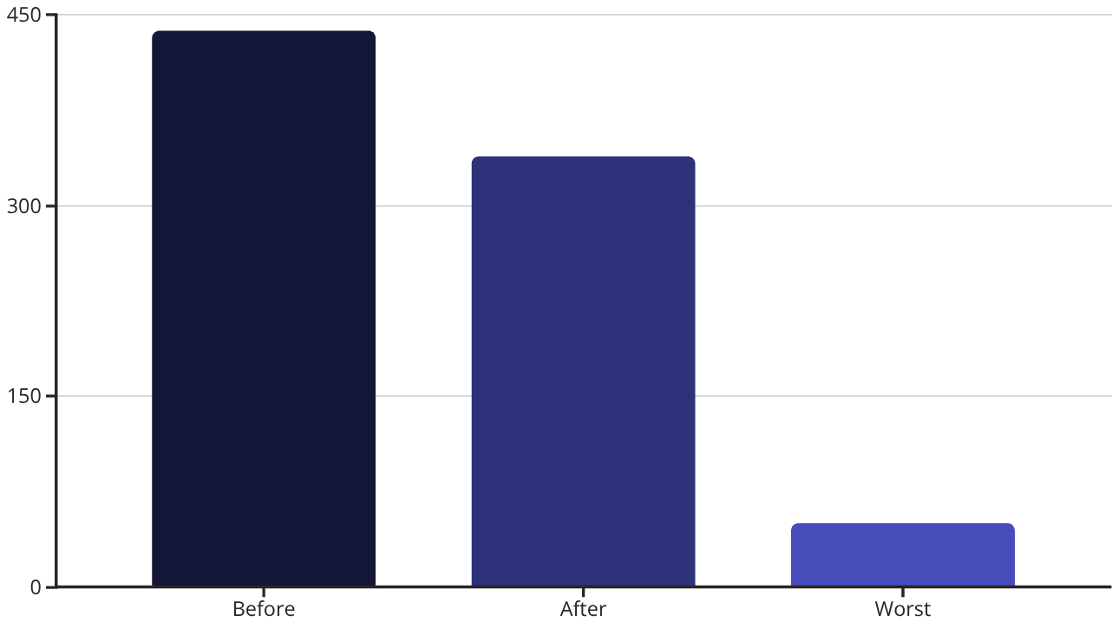
Solution 1: Parameter Tuning
The Approach
Modified bullet speed and detection radius for flames and items to optimize agent behavior.
Results
Reduced average game length from 437 ticks to 338 ticks. Achieved minimum of 4 flames in best run.
Limitation
Improved performance but lacked strategic depth. No dynamic decision-making based on game state.
4

Slide 5

Solution 2: Conditional Logic Tree
The Logic
Critical Flaw
Implementation Challenge
Failed to handle edge case where flame is positioned between agent and item, closer to agent than item. Decision tree became too rigid for dynamic gameplay.
Code design proved difficult to implement correctly. Debugging revealed numerous unhandled scenarios.
if flame-to-agent < agent-to-item: if flame-to-item > agent-to-item: catch item else: kill flame
5

Slide 6

Solution 3: Aggressive Approach
Strategy
Fatal Drawback
Agent aggressively pursued and extinguished the nearest flame without considering broader battlefield awareness.
While effective against single targets, the agent ignored other flames on the map.
Multiple flames would surround and eliminate the agent during tunnel-vision pursuit. Lacked survival instinct and spatial awareness.
Key Lesson: Local optimization ≠ global success
6

Slide 7




Final Solution: Dynamic Scenario Engine
No Target Lock-In
Scenario-Based Analysis
Re-evaluates every target and threat each frame. No commitment to stale decisions.
Analyzes 6 different scenarios simultaneously every frame for optimal decision.
Maximum Awareness
Dynamic Priorities
1000-pixel detection radius covers entire map. Nothing escapes notice.
Switches priorities instantly based on changing game situation and threats.
7

Slide 8
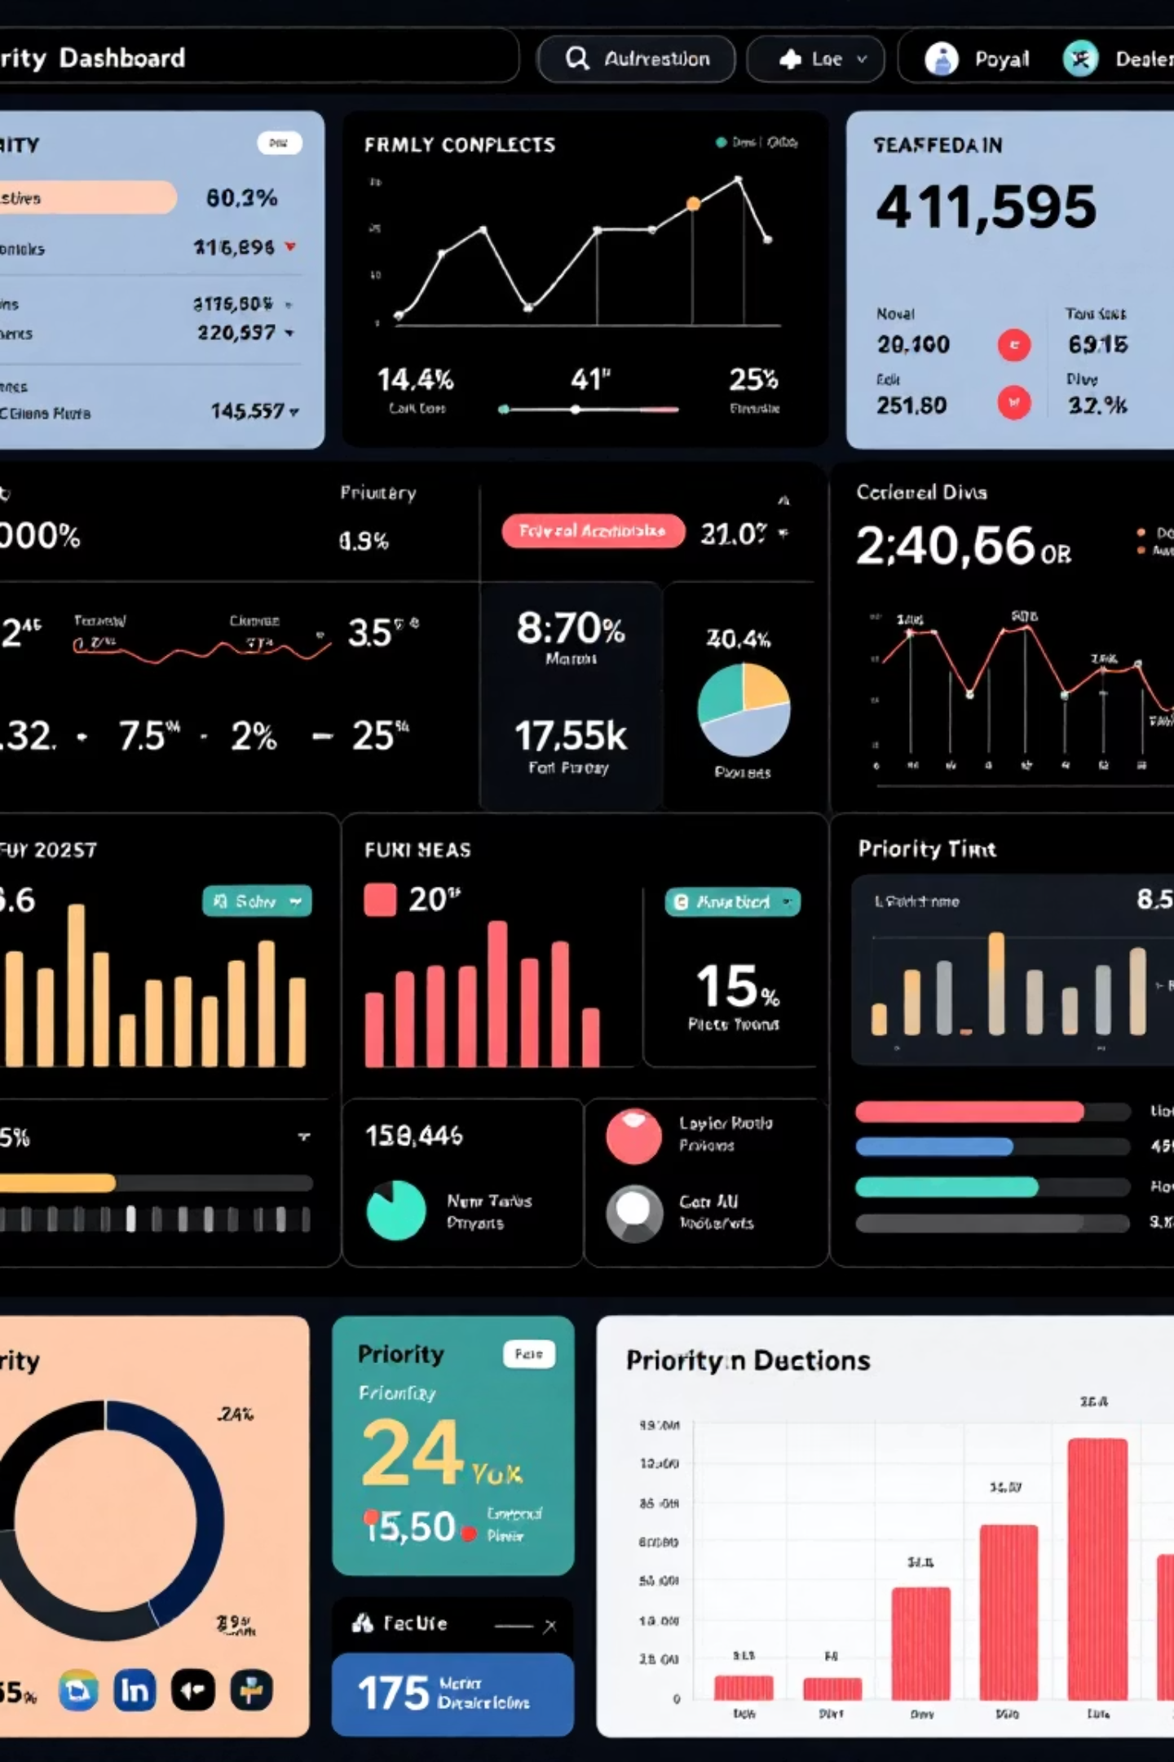
Target Priority Architecture
🔥 Yellow Flames
Base Priority: 1000
Close bonus: +500 (<150 distance)
Low HP: +600 (HP=1), +400 (HP=2)
Always prioritize moving threats
🔵 Blue Campfires
Conditional Priority
Moving: -5000 penalty (NEVER shoot)
Stationary: +1500 bonus
Tracks movement across 3 frames
Shoots only when confirmed stopped
This intelligent prioritization prevents wasted shots on invulnerable moving targets while capitalizing on stationary opportunities.
8

Slide 9



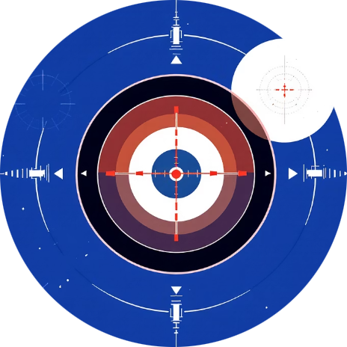
Core System Components
Corner Avoidance
Power-Up Collection
Movement System
Shooting System
Danger zone: 150px from corners. Panic distance: 100px. Maximum escape force: 10.0 toward center. Detects all 4 corner types.
1000px awareness radius. Chase strength: 8.0. Prioritizes Nuke (2000), Rapid Walk (1800), Super Bullet (1600). Path safety analysis avoids 70px flame proximity.
Priority cascade: Corner escape (10.0), wall escape (7.0), power-up chase (8.0), threat repulsion, center attraction. Maintains 180px optimal range.
Super bullets check 36 angles for 3+ targets. Normal shots prioritize yellow flames. Advanced lead calculation. Skips blocked shots.
9

Slide 10
Engineering Decisions & Measurements
1000
6
10.0
36
Detection Radius
Scenarios
Corner Force
Shot Angles
Full map awareness vs. 400px initial design
Simultaneous analysis per frame
Maximum escape urgency from death zones
Super bullet trajectory evaluation
Key Performance Features
Zero decision lag with instant re-evaluation
Corner survival system escapes death zones
No stuck behavior through continuous alternatives
Dynamic targeting switches on best value
Smart risk vs. reward item collection
Concrete metrics drove every design choice
10

